Slide 1


CHATBOTS
Chatbot for Students
Name of Students:
Shruti Manohar Narad (21BCS10829)
Yash Vijay (21BCS10752)
Udit Sanghvi (21BCS3412)
Akhilesh Kumar Singh (21BCS7126)
Divyansh Sehgal (21BCS7781)
Mentor: Abhishek Sir.
Supervisor: Ritu sharma ma’am.
Hod: Vikas wasson sir.
Class: 125-A

Slide 2

CONTENTS
INTRODUCTION TO CHATBOTS
TYPES OF CHATBOTS
FURTHER CLASSIFICATIONS OF CHATBOTS
APPLICATIONS OF CHATBOTS
ARCHITECTURES OF CHATBOTS
WORKING OF CHATBOTS

Slide 3

INTRODUCTION TO CHATBOTS
A chatbot is a computer program that simulates and processes human conversation, allowing humans to interact with digital devices as if they were communicating with a real person
CONVERSATION CAN BE EITHER TEXT-BASED OR VOICE-BASED . SOME BOTS USE BOTH METHODS OF CONVERSATION

Slide 4
TYPES OF CHATBOT
TEXT-BASED CHATBOTS
VOICE-BASED CHATBOTS

Slide 5
FURTHER CLASSIFICATION OF CHATBOTS
RULE-BASED CHATBOT ANSWERS QUESTIONS BASED ON SOME RULES ON WHICH IT IS TRAINED
SELF-LEARNING CHATBOT LEARNS HOW TO COMMUNICATE USING RESULTS OF MACHINE LEARNING MODEL TO LEARN AND ASSESS CURRENT SITUATIONS

Slide 6
APPLICATIONS OF CHATBOTS
HELPDESK ASSISTANT
HOME ASSISTANT
PHONE ASSISTANT
OPERATIONS ASSISTANT
ENTERTAINMENT ASSISTANT

Slide 7

ARCHITECTURE OF CHATBOTS
NLP MODEL
CHAT WINDOW
APPLICATION DATABASE
CORPUS
INTERFACE

Slide 8
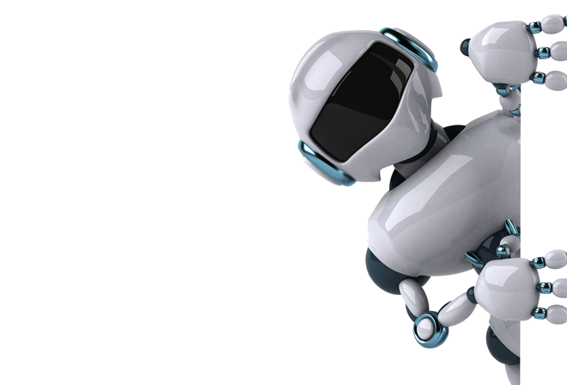
WORKING OF CHATBOTS
IMPORT CORPUS
PREPROCESS THE DATA (TEXT CASE HANDLING)
TOKENIZATION
STEMMING
BAG OF WORDS (BOW)
ONE ENCODING

Slide 9
CORPUS
TRAINING DATA FOR CHATBOTS TO LEARN
WITHOUT CORPUS IT IS IMPOSSIBLE FOR A CHATBOT TO LEARN AND REPLY SOMETHING BACK TO USER
DATA PREPROCESSING
CONVERT ALL DATA COMING AS INPUT INTO EITHER UPPER OR LOWER CASE
THIS WILL AVOID MISREPRESENTATION AND MISINTERPRETATION.

Slide 10
TOKENIZATION
THIS IS TOKENIZATION
THIS
IS
TOKENIZATION
STRUCTURED PROCESS OF CONVERTING A SENTENCE INTO INDIVIDUAL COLLECTION OF WORDS

Slide 11
STEMMING
ORIGINAL WORD | ROOT WORD | SIMILAR WORD(SAME AS ROOT WORD)
JUMP | JUMP | SIMILAR WORD IS JUMP
JUMPS | JUMP | SIMILAR WORD IS JUMP
JUMPED | JUMP | SIMILAR WORD IS JUMP
JUMPING | JUMP | SIMILAR WORD IS JUMP
STEMMING IS THE PROCESS OF FINDING SIMILARITIES BETWEEN WORDS WITH THE SAME ROOT WORDS

Slide 12
GENERATING BAG OF WORDS(BOW)
It is the process of converting words into numbers by generating vector embeddings from the token generated
ENCODING
IT IS PROCESS BY WHICH CATEGORICAL VARIABLES ARE CONNECTED INTO A FORM THAT ML ALGORITHMS USE

Slide 13
THANK YOU

